Slide 1

Smart home project

Slide 2
Team:
Mohamed Emad
Mohamed Ramadan
Essam Ashraf
Mariam shrief
Elham Aboelezz Hamada

Slide 3
Agenda
Introduction
Objectives
Features
Implementation
Benefits

Slide 4
Introduction
Smart home technology intelligently gives us the ultimate control over our home by automating the lighting system ,dimming , electrical appliances and security system .
Smart home connect all devices in our home so that they can communicate with each other and with us.
It helps us create a comfortable home and effective lifestyle.
Smart home work fairly simple systems : receivers and transmitters .
Receiver detect a certain signal from the transmitter that issues a command.

Slide 5
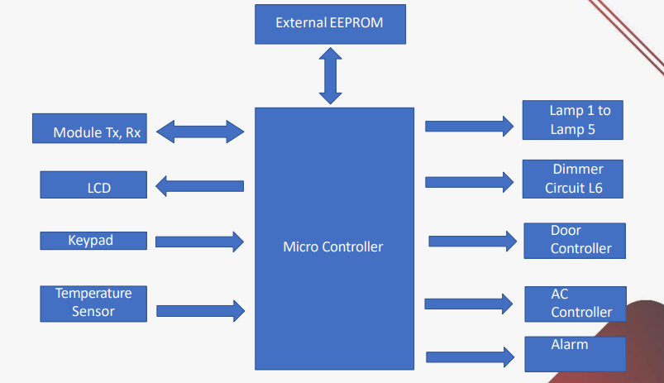
System analysis:

Slide 6
Features:
Door lock
Air conditioner
Lamps
Alarm

Slide 7
Implementation :
In our system
we have two modes :
Admin mode : can register any user or remove .
User mode : use LCD and Keypad and can access to all applies except the door opening.
Remoted controlled by mobile or lab top
For emergency cases or controlling without mobile or lap-top use LCD and Keypad “user mode only”.
If admin or any user or passwords are entered wrong more than 3 trial, the system must break down and fire alarm until reset.

Slide 8
Component:
LCD&KEYPAD
They are used to login to system as a user only.
After login, user can control all features except opening door.
They can control the system even if any user login by remoted mode except admin until allowing of admin.
The interfacing of LCD must display the running devices if the keypad-LCD system is not used.
The user’s usernames in this system different than the user’s usernames in the remoting system.

Slide 9
EEPROM
Storing the new user to the system “registration”.
It must be Read/write in admin mode.
It must be read only in user mode.
TTL/Bluetooth
Transmitting/Receiving between MC and PC/mobile.
Every action, Message must be printed on Mobile/PC screen, like: Hey, please Enter your username: .
Transmitting/Receiving the commands to run the system.

Slide 10
Temperature Sensor, DC motor
Temperature sensor reads the ambient temperature, if the temperature is higher than 28 °C, Air condition must be run “DC motor”, if the temperature becomes lower than 21 °C, Air condition must be turned off “DC motor”.
Door
The actuator used is a servo motor to control the opening door only in admin mode, it is controlled by command which is send by Mobile/PC “Open\Close the door”.

Slide 11

Some important functions in our code :
This our main function to run the application
This fun select which feature is running ( RESET , LOGIN, CONTROL, LOCKED )
This fun select if you are ADMIN or USER

Slide 12
This fun give the virtual access
This fun give the access using keypad
This fun take you to the block state and run the alarm

Slide 13
Benefits
Convenience: control your home from any where
Energy efficiency : reduce energy consumption and costs
Security :enhanced protection with real time alerts
Comfort: personalized settings for a comfortable living environment

Slide 14
Thank you

